Slide 1

IMPACT OF RECESSION ON RETAIL SECTOR
Presentation by Group 2
Ayisha Razana Shilpa George Mentor : Varun
Sruthi Sankar

Slide 2
Business Objective
To predict the customers, who likely to purchase from that retail store in the next month(2012-1-1)

Slide 3


Literature survey- Recession analysis
https://link.springer.com/article/10.1057/elmr.2009.140
https://ec.europa.eu/eurostat/web/products-statistics-in-focus/-/KS-SF-09-088

Slide 4
Overview of dataset
The data contains purchase/shopping history of customers from 2010-12-01 08:26:00 till 2011-12-09 12:50:00
Total transaction in this period 25,900
Dataset size (541909, 8)
Attributes
InvoiceNo : object
StockCode : object
Description : object
Quantity : int64
InvoiceDate : datetime64[ns]
UnitPrice : float64
CustomerID : float64
Country : object

Slide 5
Exploratory Data analysis
Each observation consists of quantity of the item, customer has purchased.
There are Missing data in ‘Description’ and ‘Customer ID ‘
No of missing data:
Description 1454 (0.268311%)
CustomerID 135080 (24.926694%)
Dataset contains transactions from 38 countries
Top 5 observations:
United Kingdom 495478 (91.43%)
Germany 9495 (1.75%)
France 8557 (1.57%)
EIRE 8196 (1.51%)
Spain 2533 (0.46%)
There are 4070 unique stock code
4373 customers from 38 different countries

Slide 6
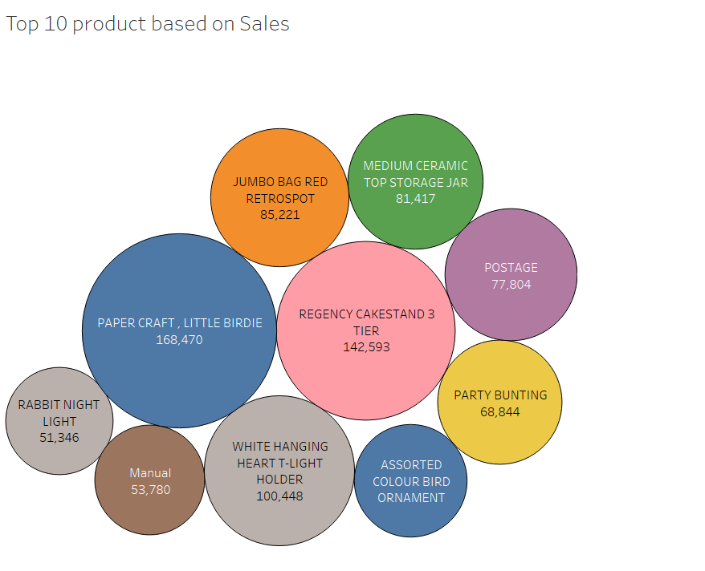
Top Products and Countries
Top 5 Countries with highest item purchases:
United Kingdom 495478
Germany 9495
France 8557
EIRE 8196
Spain 2533

Slide 7
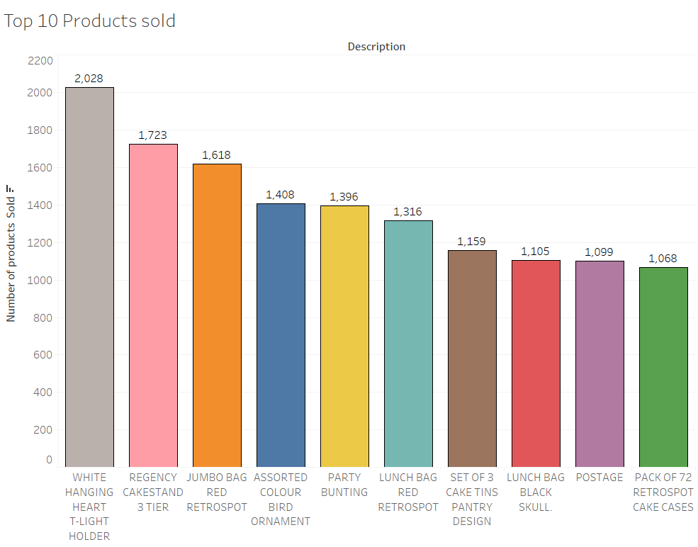
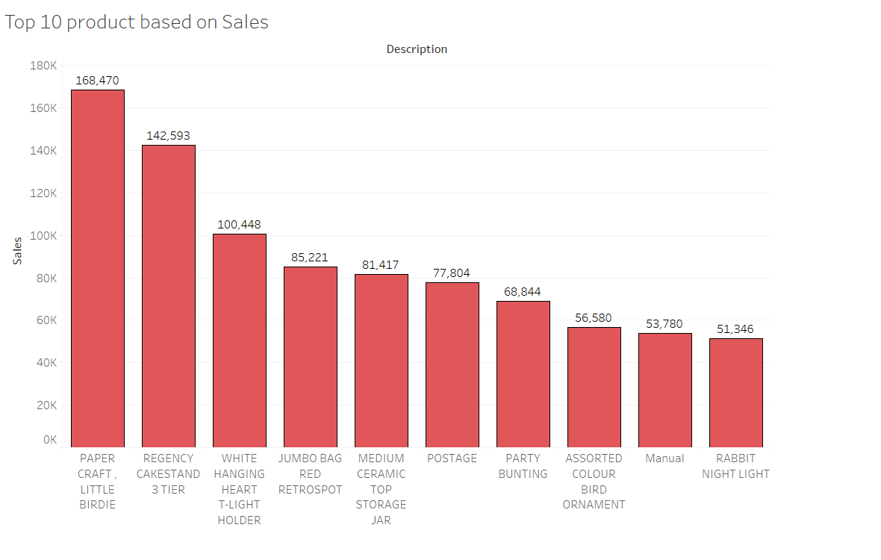
Analysis on Top products

Slide 8
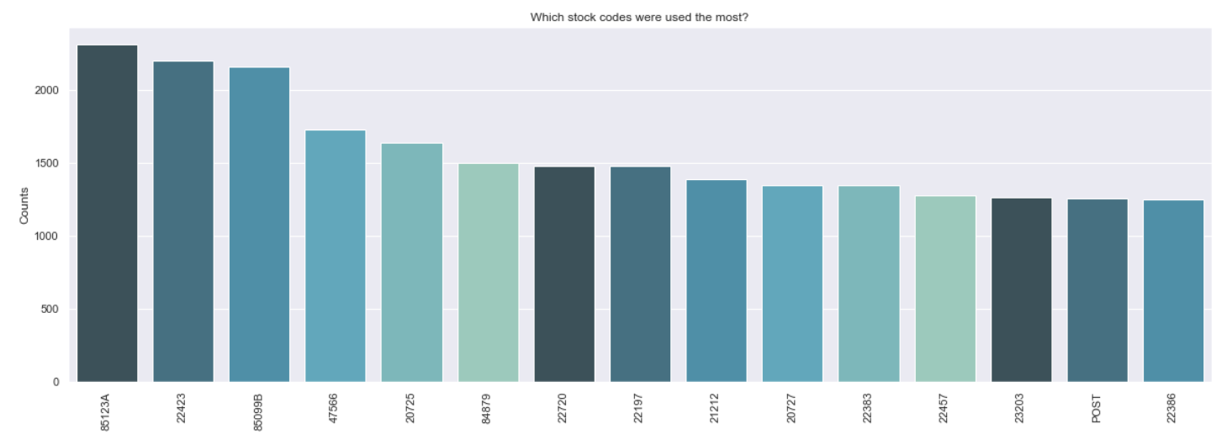
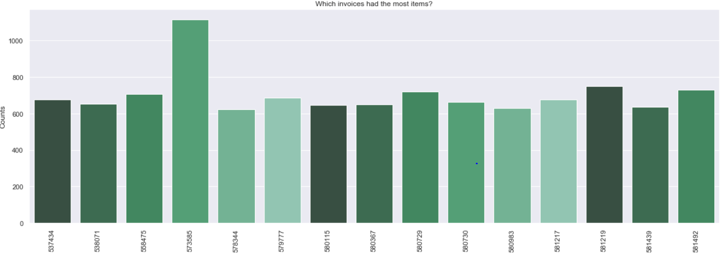
Stock codes and Invoices analysis

Slide 9
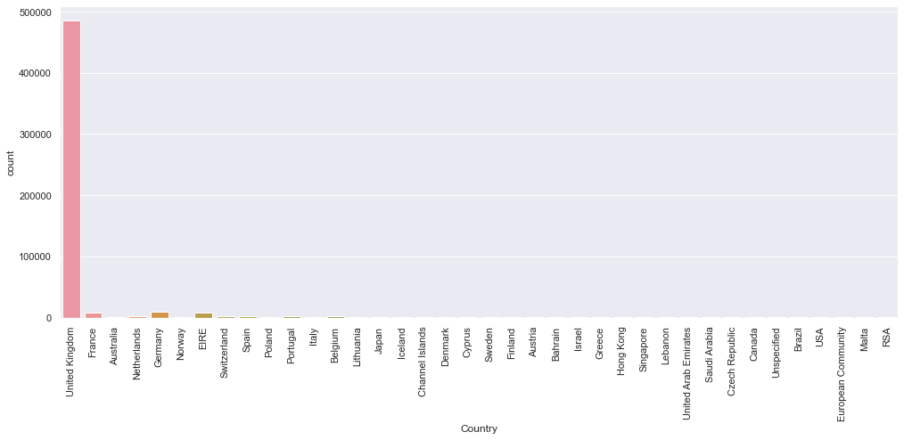
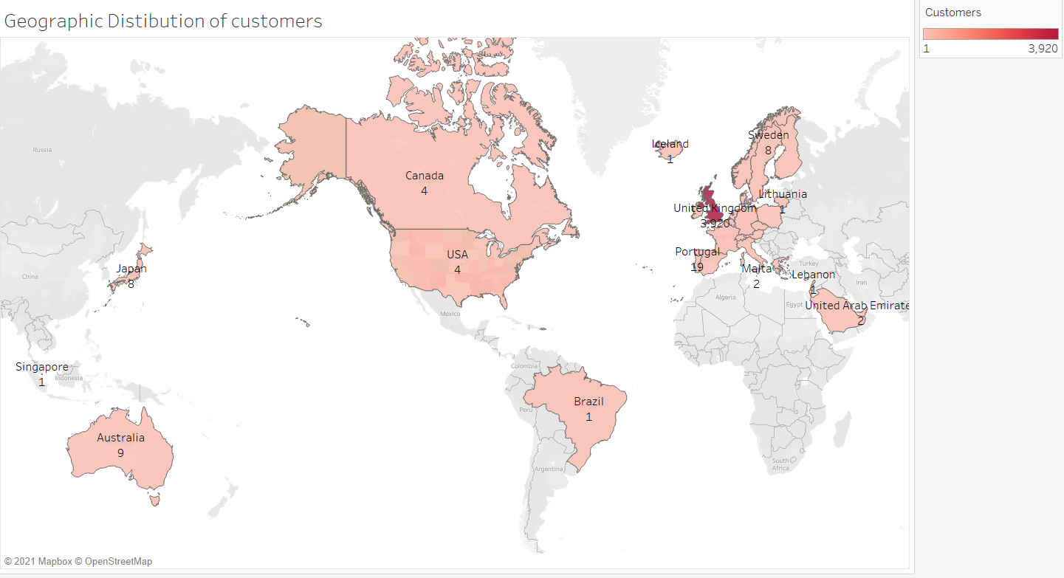
Geographic distribution of customers

Slide 10
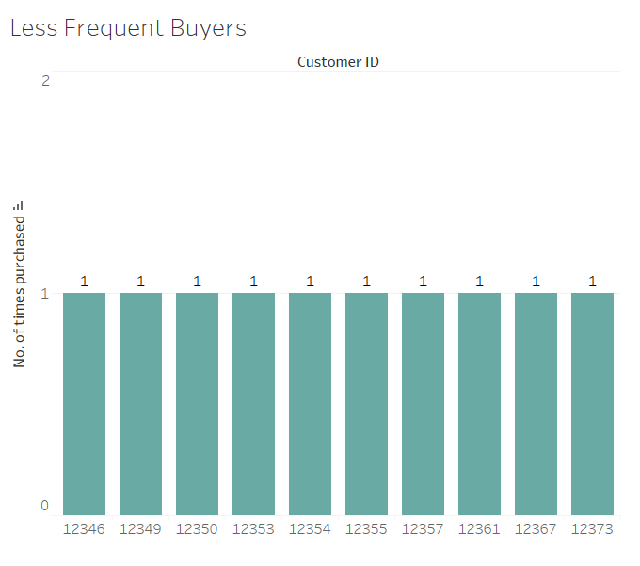
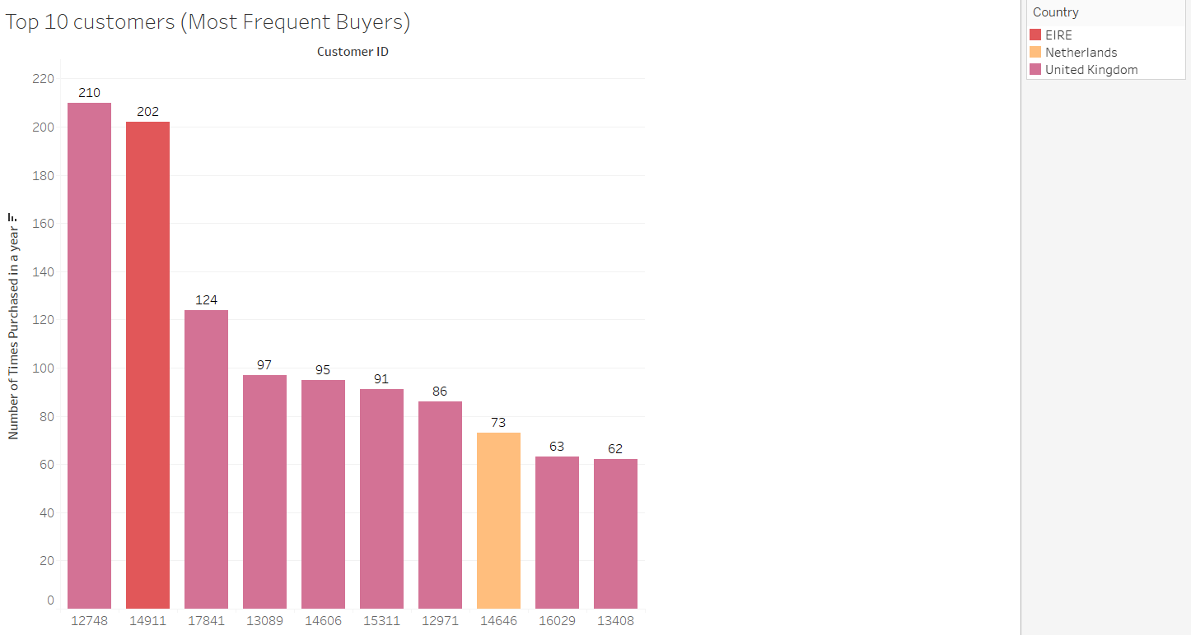
Customer frequency analysis

Slide 11
Transaction analysis
Top 5 transactions by the customers;
Customer id no of transactions
12415 778
12471 531
12540 481
12567 463
12474 457
Invoice no which starts with ‘A’ has Negative Unit price transactions with description as ‘Adjust bad debt’.
For example - A563185, A563186, A563187
Invoice no which starts with ‘C’ has Negative Quantity which is cancelled order.
Some of the stock code are alpha-numeric with 5 digits and 1 character at the end.

Slide 12
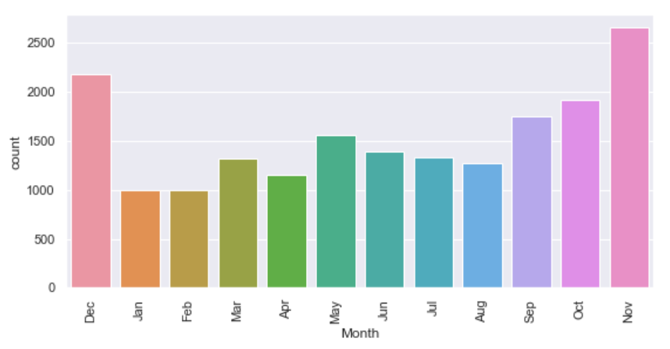
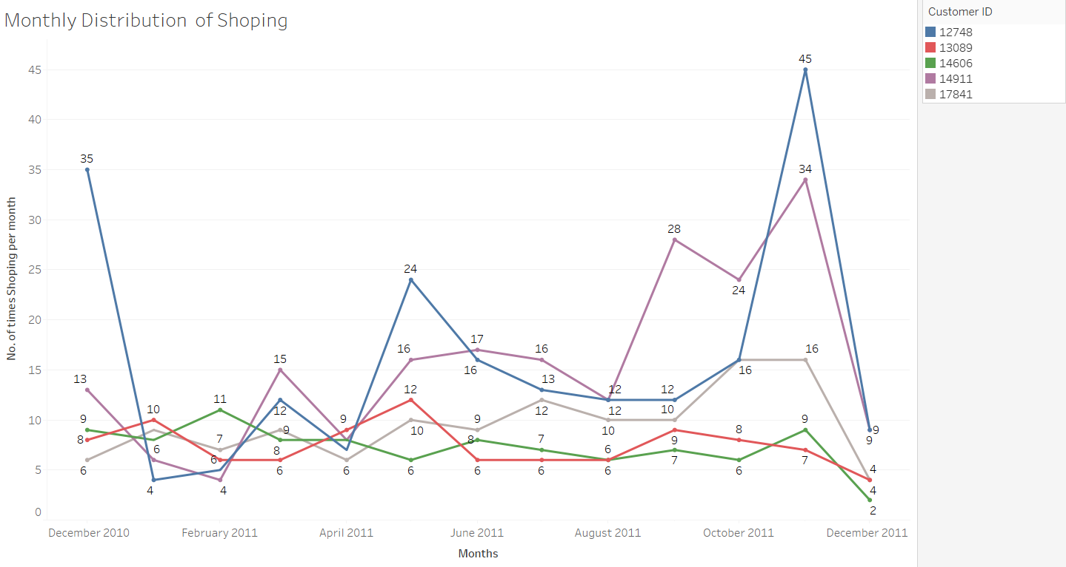
Monthly purchase analysis

Slide 13
Data cleaning
Cancelled Transactions
Unit Price, Quantity <= 0
CustomerID – Null data
POSTAGE, DOTCOM POSTAGE, Bank Charges, AMAZON FEE, Next Day Carriage, PACKING CHARGE, Adjust bad debt
Duplicates
Before 541909, 8
After 386660, 8

Slide 14
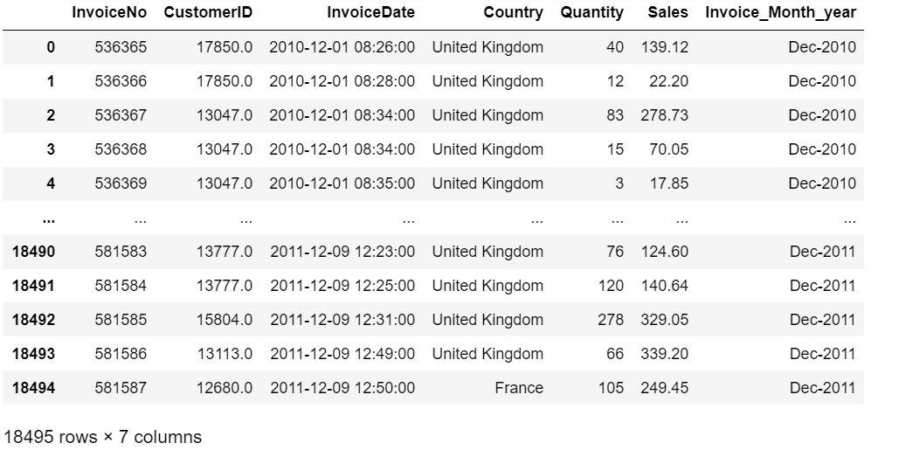
Data transformation
Sales = quantity * unit price
Data grouped by invoiceNo. & Customer ID
Quantity & Sales are aggregated for each InvoiceNo.

Slide 15
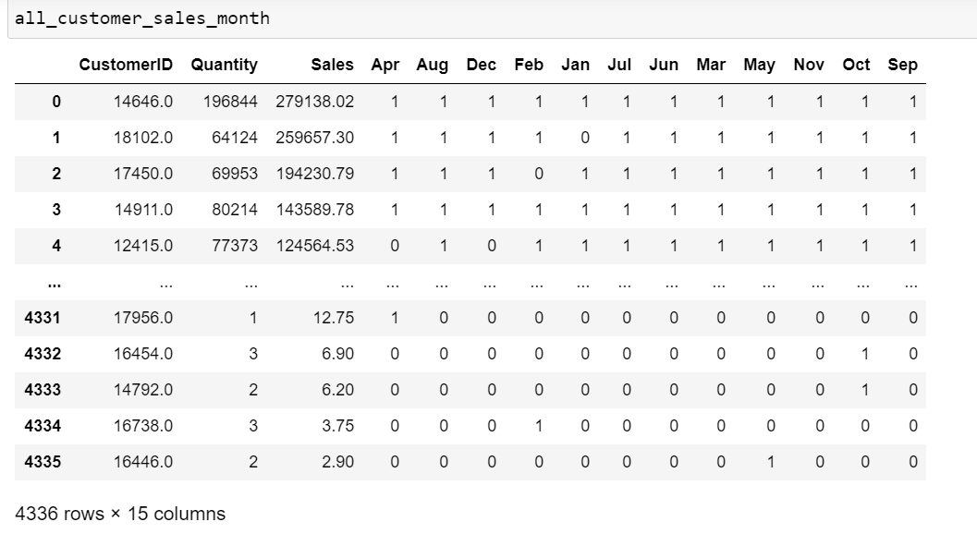
Data transformation- ‘customer’ vs ‘sales’ vs ‘month’
Marked total sales & quantity per customer
Encoding of transactions in month wise
‘multilabel classification’ using ‘multilabel binarizer’

Slide 16
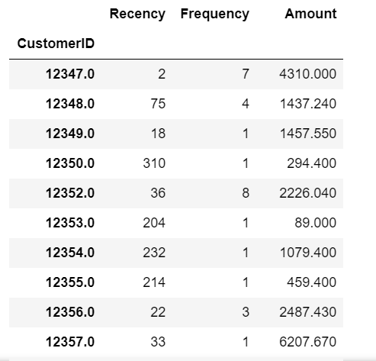
Model Building- RFM / Clustering
RFM Analysis - Recency , Frequency , Monetary
Recency : Present Date – Last Purchase Date
Frequency : Total Number of Purchases
Monetary : Total Amount of Purchase

Slide 17
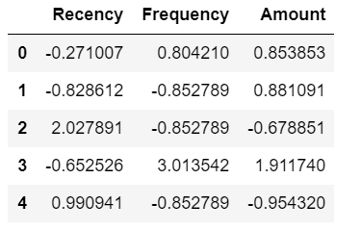
Pre-processing on rfm data
Outlier Treatment on : R- F- M Parameters – Using IQR.
Standardisation of RFM data frame using Standard Scaler
Hopkins Test on normalised RFM data to check clustering tendency – result : 0.92

Slide 18
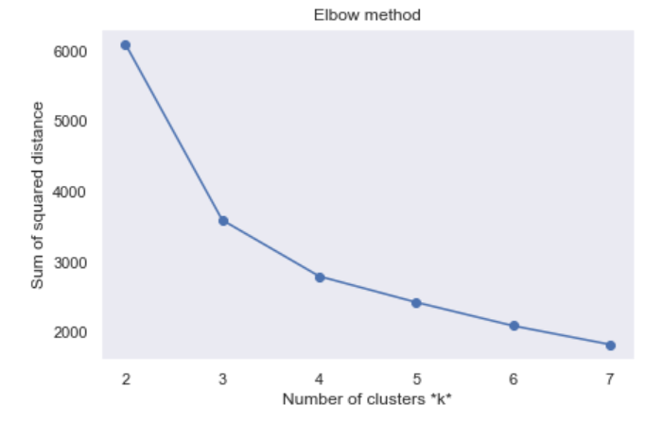
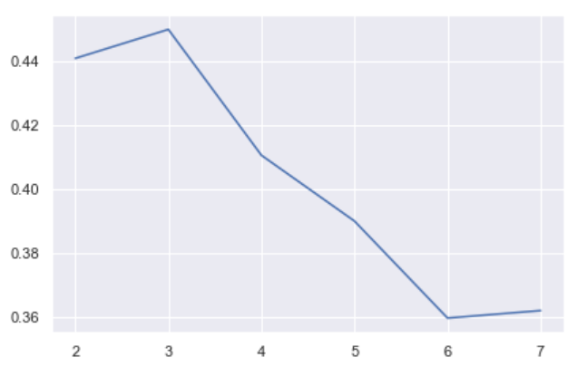
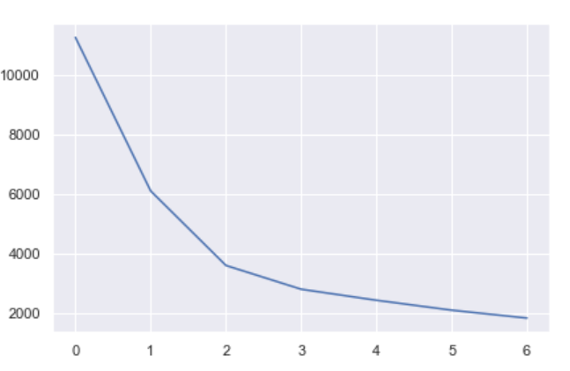
K-Means clustering
Applying K-Means Clustering on standardised RFM data
Elbow Curve – optimum no.of clusters - 4
Silhouette_Score- how close each data points in one cluster to the other points in neighbouring cluster
Sum of Squared distances - squared average distance of all the points within a cluster to the cluster centroid

Slide 19
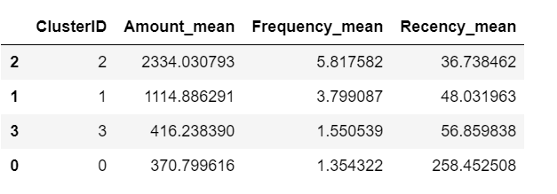
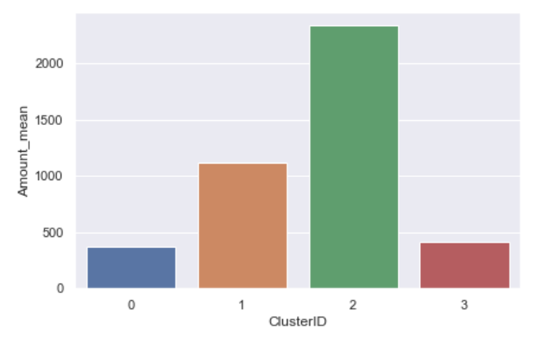
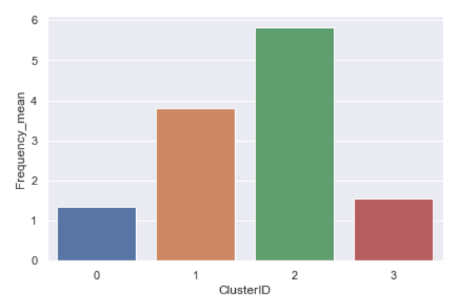
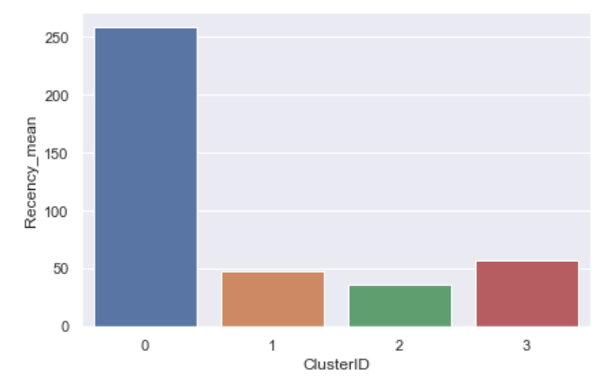
Analysis on clusters
Calculated mean value of R-F-M for each cluster – choose least recency_mean, high frequency_mean cluster as Best customer’s cluster.

Slide 20
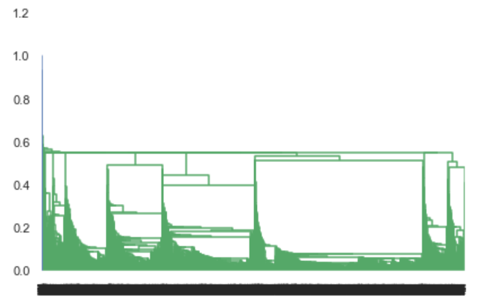
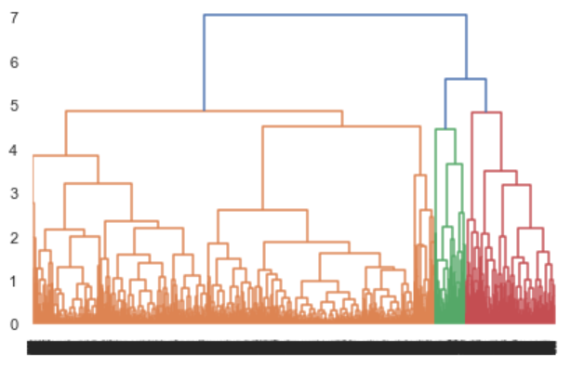
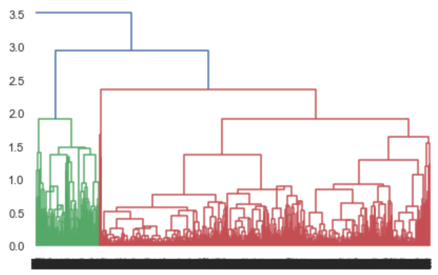
Hierarchical clustering
Single Linkage
Centroid Linkage
Centroid Linkage
Complete Linkage gives good clusters- 4 clusters

Slide 21
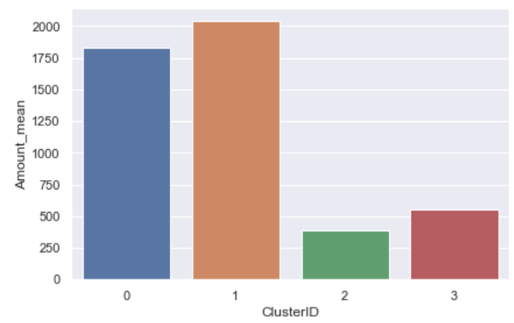
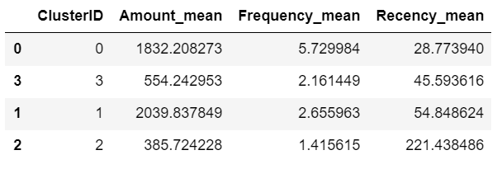
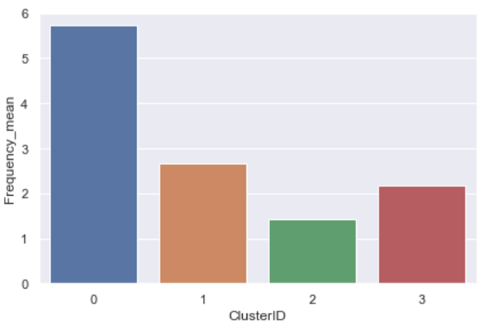
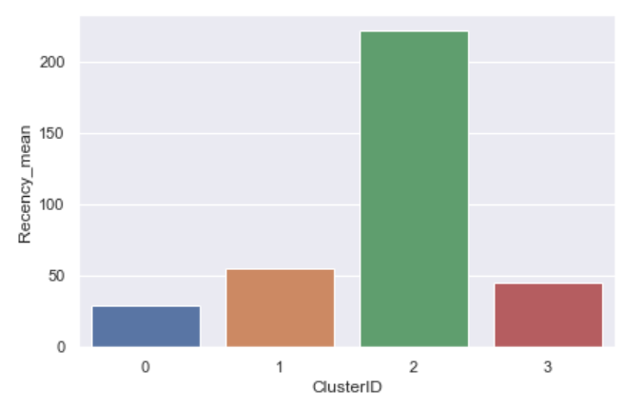
Analysis on clusters
Calculated mean value of R-F-M for each cluster – choose least recency_mean, high frequency_mean cluster as Best customer’s cluster.
Sorted - Mean values of RFM for Each clusters

Slide 22
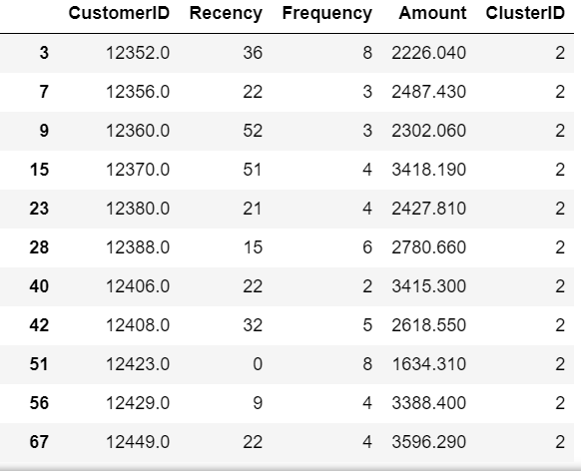
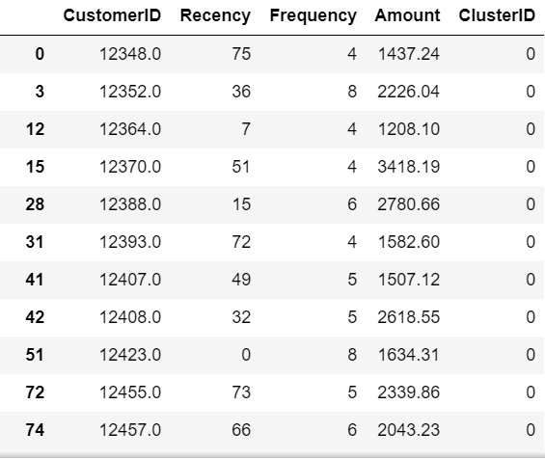
Output analysis - top Customers
RFM - K-Means
RFM - Hierarchical

Slide 23
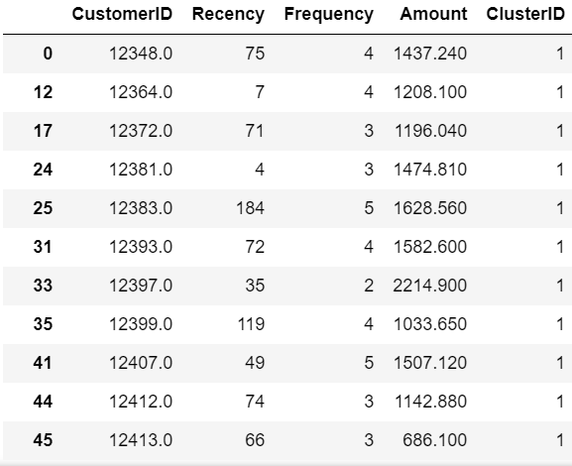
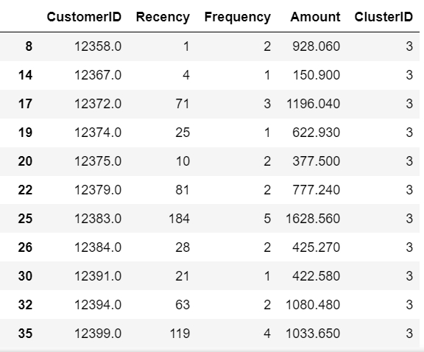
Output analysis – IInd top Customers
RFM – K-Means
RFM - Hierarchical

Slide 24
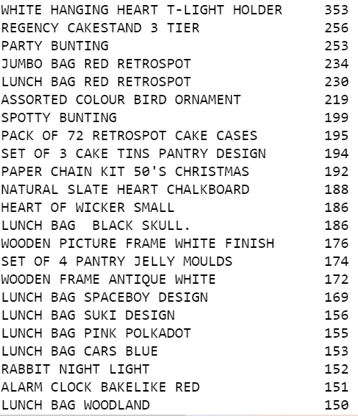
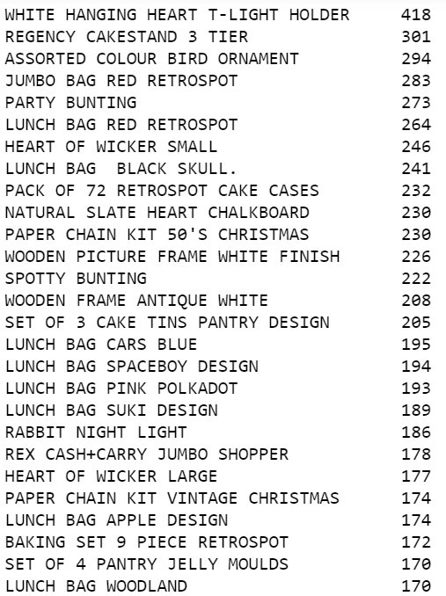
Output analysis – Top products of top customers
K-Means
Hierarchical

Slide 25
Final Outputs
Expected Customers : Best cluster customers from K-means Clustering
Expected Day of Next Purchase : Last purchase day + mean (intervals between each purchase)
Expected Quantity of Next Purchase : Total purchased quantity / Frequency
Expected Amount : Total purchased amount / Frequency
Expected Products : Frequently purchased products

Slide 26
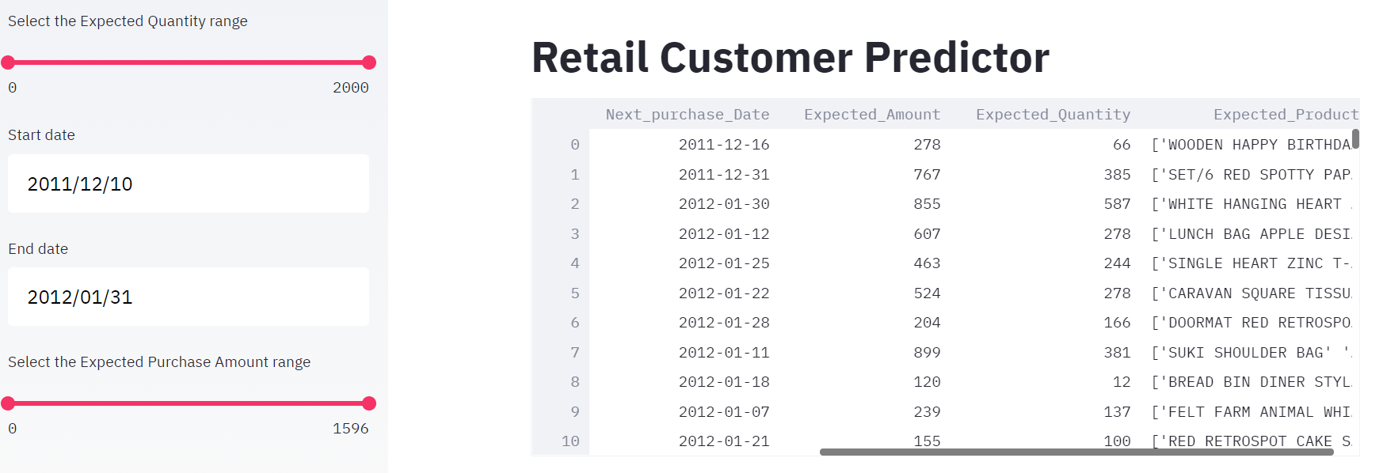
Deployment - streamlit
Filters
Start and Ends dates – Choose dates from calendar
Expected Amount Range– Drag between values
Expected Quantity Range – Drag between values

Slide 27
Challenges
EDA : To identify the non-product transactions like bank charges, postage fee etc.. ,Had to use excel filter option and wrote down them.
Modelling : Needed to study about customer segmentation and prediction methods which was not familiar before. eg: RFM analysis.
Python Coding: Difficulty was there in coding, to find the next purchase day in future by using shift, and day difference calculating methods.

Slide 28

Thank You

